Slide 1
GIS Based Spatial Suitability Analysis for
Telecommunication Tower Placement in Embu County, Kenya
Registration No. | Name
E020-01-1653/2022 | KENNETH KIMOSOP KIPCHIRCHIR
E020-01-1155/2022 | IVONNE BITENGO MAYAKA
E020-01-1143/2022 | SALMON ANYANDA MUSINA
LECTURER: Dr. KURIA
D
E
Y
D
G
AN
O
IV T
L
K
IM
AT
HI
UN
ERSI
Y O
F T
EC
H
NO
FRIDAY, 2ND AUGUST 2026
Dedan Kimathi University of Technology

Slide 2
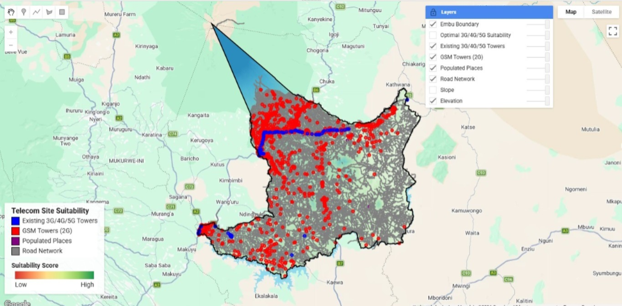
Background
Problem Statement
Spatial planning problem
No RF drive-test / signal measurement data was available
Infrastructure, settlement, road, and terrain layers are integrated instead
Output identifies where recorded advanced sites are sparse relative to population and access
“Digital divide” here refers to infrastructure distribution, not confirmed signal coverage
Embu County contains both urban and rural settlements, but the recorded distribution of advanced cellular infrastructure (3G/4G/5G) is not spatially uniform. Some populated areas lie farther from recorded advanced network sites than others, and high terrain variability adds a further constraint on where new infrastructure is practical.
Without integrating infrastructure, settlement, road, and terrain data spatially, it is difficult to identify areas that warrant further investigation — leaving some communities more isolated from advanced connectivity than others. This project uses GIS and open spatial data to analyse these factors and produce a suitability surface for potential tower placement.
2

Slide 3
Aim and Objectives
Main Objective
To assess the spatial suitability of areas in Embu County for potential telecommunication tower placement using GIS.
Specific Objectives
Map the recorded spatial distribution of cellular infrastructure in Embu County.
Identify spatial gaps between populated places and recorded advanced (3G/4G/5G) network sites.
Evaluate terrain constraints (elevation and slope) relevant to potential infrastructure placement
Combine infrastructure, settlement, road, and terrain factors using a weighted overlay model.
Propose candidate zones with higher suitability scores for further investigation.
3

Slide 4
METHODOLOGY
Data Acquisition
Dataset | Source | Type | Purpose
County boundary | GADM | Vector polygon | Define study area
Cell site records | OpenCelliD | Point (CSV) | Existing recorded network infrastructure
Roads | HDX | Line | Accessibility factor
Populated places | HDX | Point | Settlement proximity factor
DEM | USGS SRTM 30m | Raster | Elevation and slope derivation
All data is open-source. Within the study area, OpenCelliD contained 1,341 recorded cell site records , of which 118 were classified as UMTS, LTE, or NR — plus 37 populated places. These are recorded as counts, not a confirmed inventory of every physical site: OpenCelliD is crowdsourced and may be incomplete.
4

Slide 5
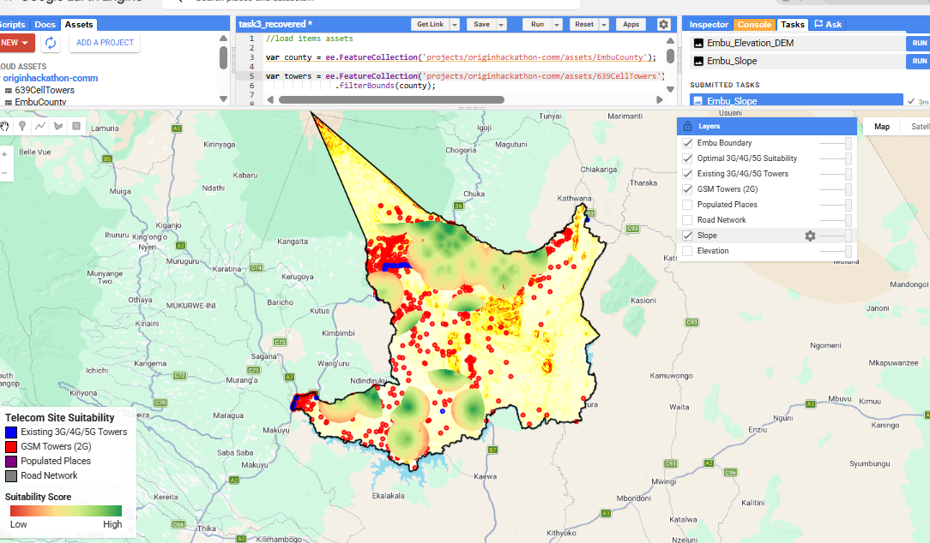
METHODOLOGY — PART 1
Why Google Earth Engine
Raw OpenCelliD CSV required filtering by the radio field (2G vs 3G/4G/5G) before use
Distance calculations (site-to-site, site-to-settlement, site-to-road) across the full county are computationally heavy in desktop GIS
GEE's server-side raster/vector processing handled these operations without the geometry and rendering lag QGIS showed on the full dataset
All filtering, distance calculation, normalization, and weighted overlay were performed in GEE using JavaScript
QGIS was used afterward, purely for final cartographic layout
GEE code editor — radio field filter for GSM ,UMTS ,LTE

Slide 6
METHODOLOGY — PART 2
The Suitability Model
Factors Used
Weighted Overlay
Proximity to populated places (settlement proximity)
Distance from recorded advanced network sites (infrastructure gap proxy)
Proximity to roads (accessibility)
Elevation
Slope — areas above 25° excluded from the model
Factor | Weight
Settlement proximity | 35%
Distance from advanced sites | 25%
Road accessibility | 20%
Elevation | 10%
Slope | 10%
S = 0.35P + 0.25G + 0.20R + 0.10E + 0.10T
S = suitability score · P = settlement proximity · G = infrastructure-gap suitability · R = road accessibility · E = elevation · T = slope

Slide 7
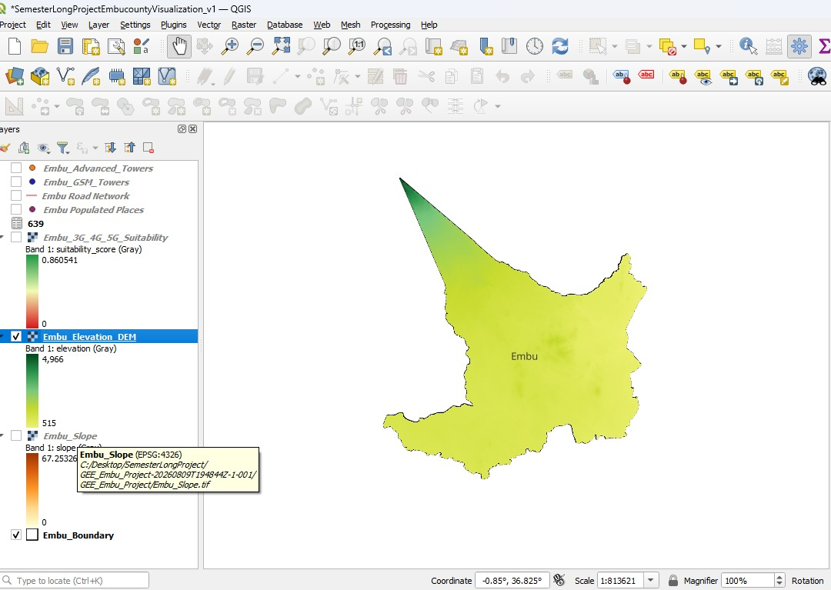
METHODOLOGY — PART 3
QGIS Cartography
Final rasters (suitability surface, slope) and vector outputs exported from GEE as GeoTIFF / Shapefile
Imported into QGIS for symbolization, layout, and final map production only — no further spatial analysis performed in QGIS
Standard cartographic elements applied: legend, north arrow, scale bar, coordinate grid, source labels
CRS: WGS 84 / UTM Zone 37S — EPSG:32737
7
QGIS Layers panel + Print Layout of the final map composition

Slide 8
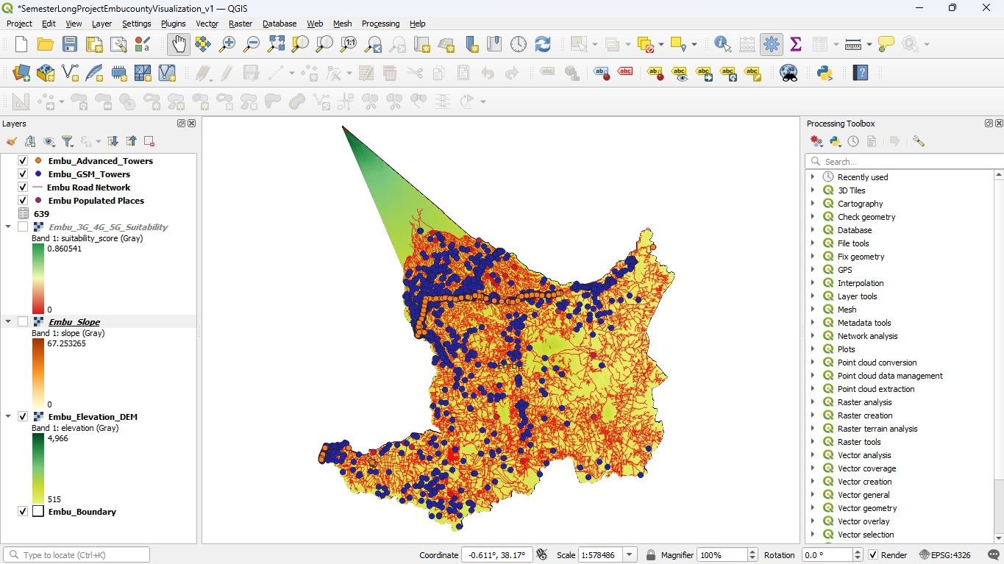
RESULTS — MAP 1
Infrastructure & Existing Sites
[Insert Actual Map]
Study Area and Existing Infrastructure — cell sites, advanced sites, roads, populated places, county boundary
8

Slide 9
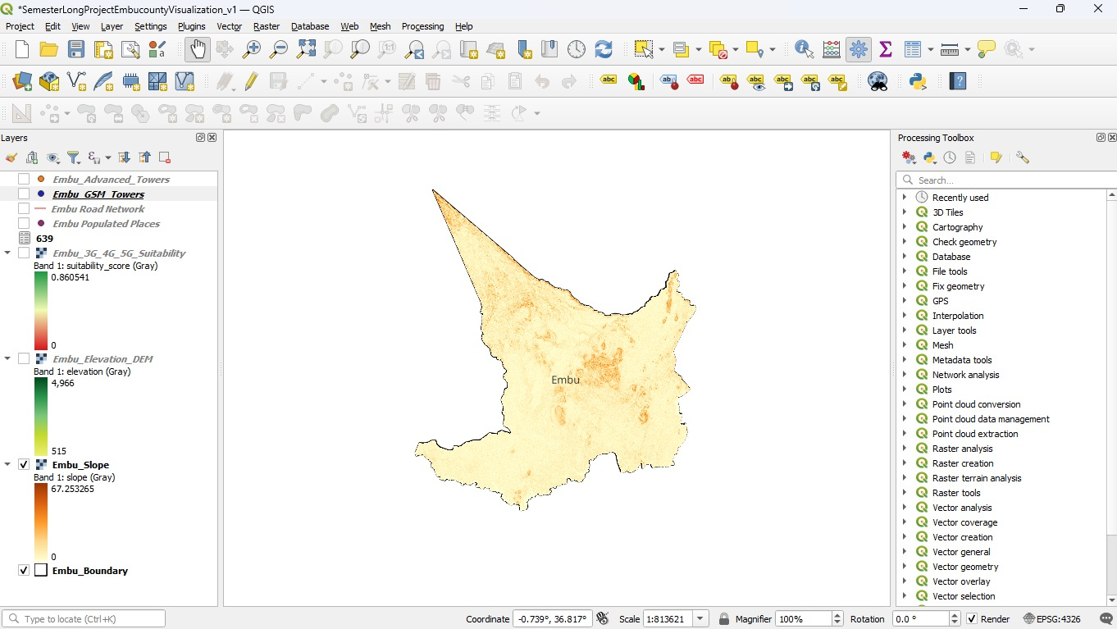
RESULTS — MAP 2
Terrain Constraints
9
Terrain and Accessibility Constraints slope classification, areas excluded above 25°, road network

Slide 10
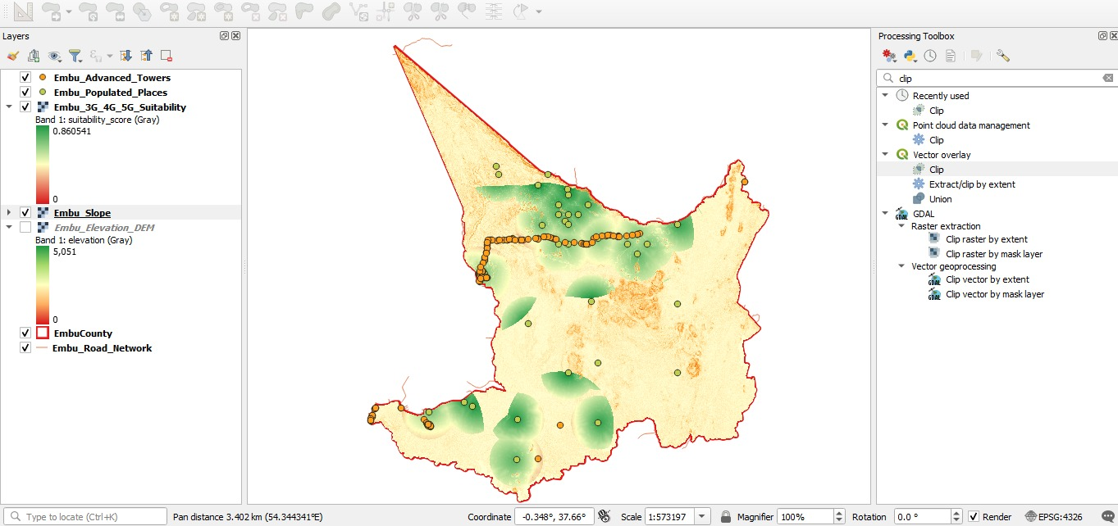
RESULTS — MAP 3
Final Site Suitability Analysis
10
Final Spatial Suitability Map — classes: Highly Suitable / Moderate / Low / Unsuitable

Slide 11
Discussion & Policy Implications
Higher suitability areas represent locations satisfying more of the selected criteria under this weighting scheme not confirmed optimal tower sites
These areas tend to sit near populated places and roads, and farther from recorded advanced sites, consistent with the model's design
Policy relevance: candidate zones can guide where to prioritize field assessment and operator engagement, not where to build
Terrain exclusions show physical siting constraints that exist independent of demand
What the results DO show
What the results DO NOT show
Candidate zones for further technical and field investigation, based on the selected spatial criteria and weights.
Measured signal strength, guaranteed coverage improvement, or confirmed final tower locations.
11

Slide 12
Conclusion & Recommendations
Limitations
Conclusion
Recommendations
OpenCelliD is crowdsourced — may not capture every operational site
Does not model RF propagation (signal strength, path loss, link budget)
Settlement points do not represent exact population counts
Results depend on the chosen factor weights
No field verification was conducted
GIS was used to integrate recorded infrastructure, settlement, road, and terrain data into a single spatial analysis
The output is a set of candidate areas with higher suitability scores for potential future infrastructure in Embu County
Field-verify candidate areas
Obtain more complete infrastructure data where possible
Perform RF propagation analysis before any siting decision
Consult network operators for engineering validation
12

Slide 13



THANK YOU
Private Bag- Dedan kimathi, Nyeri-Mweiga road
Telephone: +254-061 2050000 Email: vc@dkut.ac.ke Website: www.dkut.ac.ke
D
Y
E
G
D
AN
O
IV T
L
K
IM
AT
HI
UN
ERSI
Y O
F T
EC
H
NO
Dedan Kimathi University of Technology

